Slide 1
InFectious Diseases Storage Web
IDSw
Home
About Us
Services
The Web
Contact
IDSw.
Project By:
Rodrigo Fernández Sánchez
Amalia Rial Plaza
Lorena Cano Díaz-Maroto
Jorge García Guajardo

Slide 2
About us
IDSw
Home
About Us
Services
The Web
Contact
IDSw is a web-based application designed to manage infectious diseases data. It offers a range of features for storing, updating, inserting, and deleting information related to various viral or bacterial infectious diseases.

Slide 3

Our services
IDSw
Home
About Us
Services
The Web
Contact
diseases
symptoms
Store and manage information on infectious diseases.
Record and manage symptoms.
treatment plans
diagnoses
Store treatment plans associated with specific diseases and diagnoses with detailed descriptions.
Track diagnoses made by Doctors associated with specific Medical Records and Patients.

Slide 4

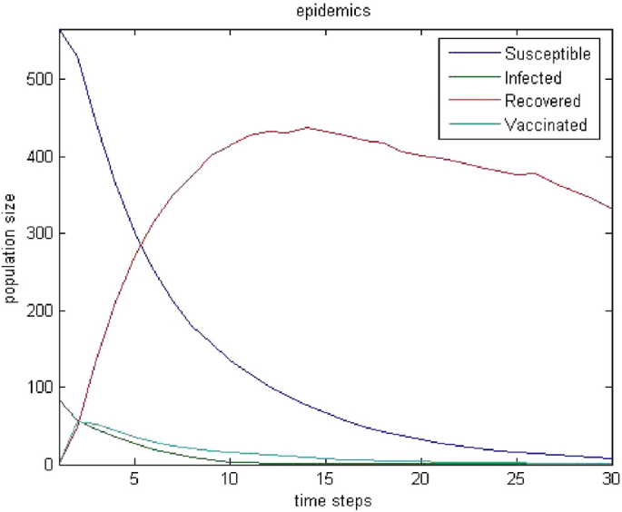
Our services
IDSw
Home
About Us
Services
The Web
Contact
Medical records
Store and manage patient medical records, including multiple diagnoses, each with its specific treatment plan.
simulations
Simulate disease spread and progression based on user-defined parameters.

Slide 5
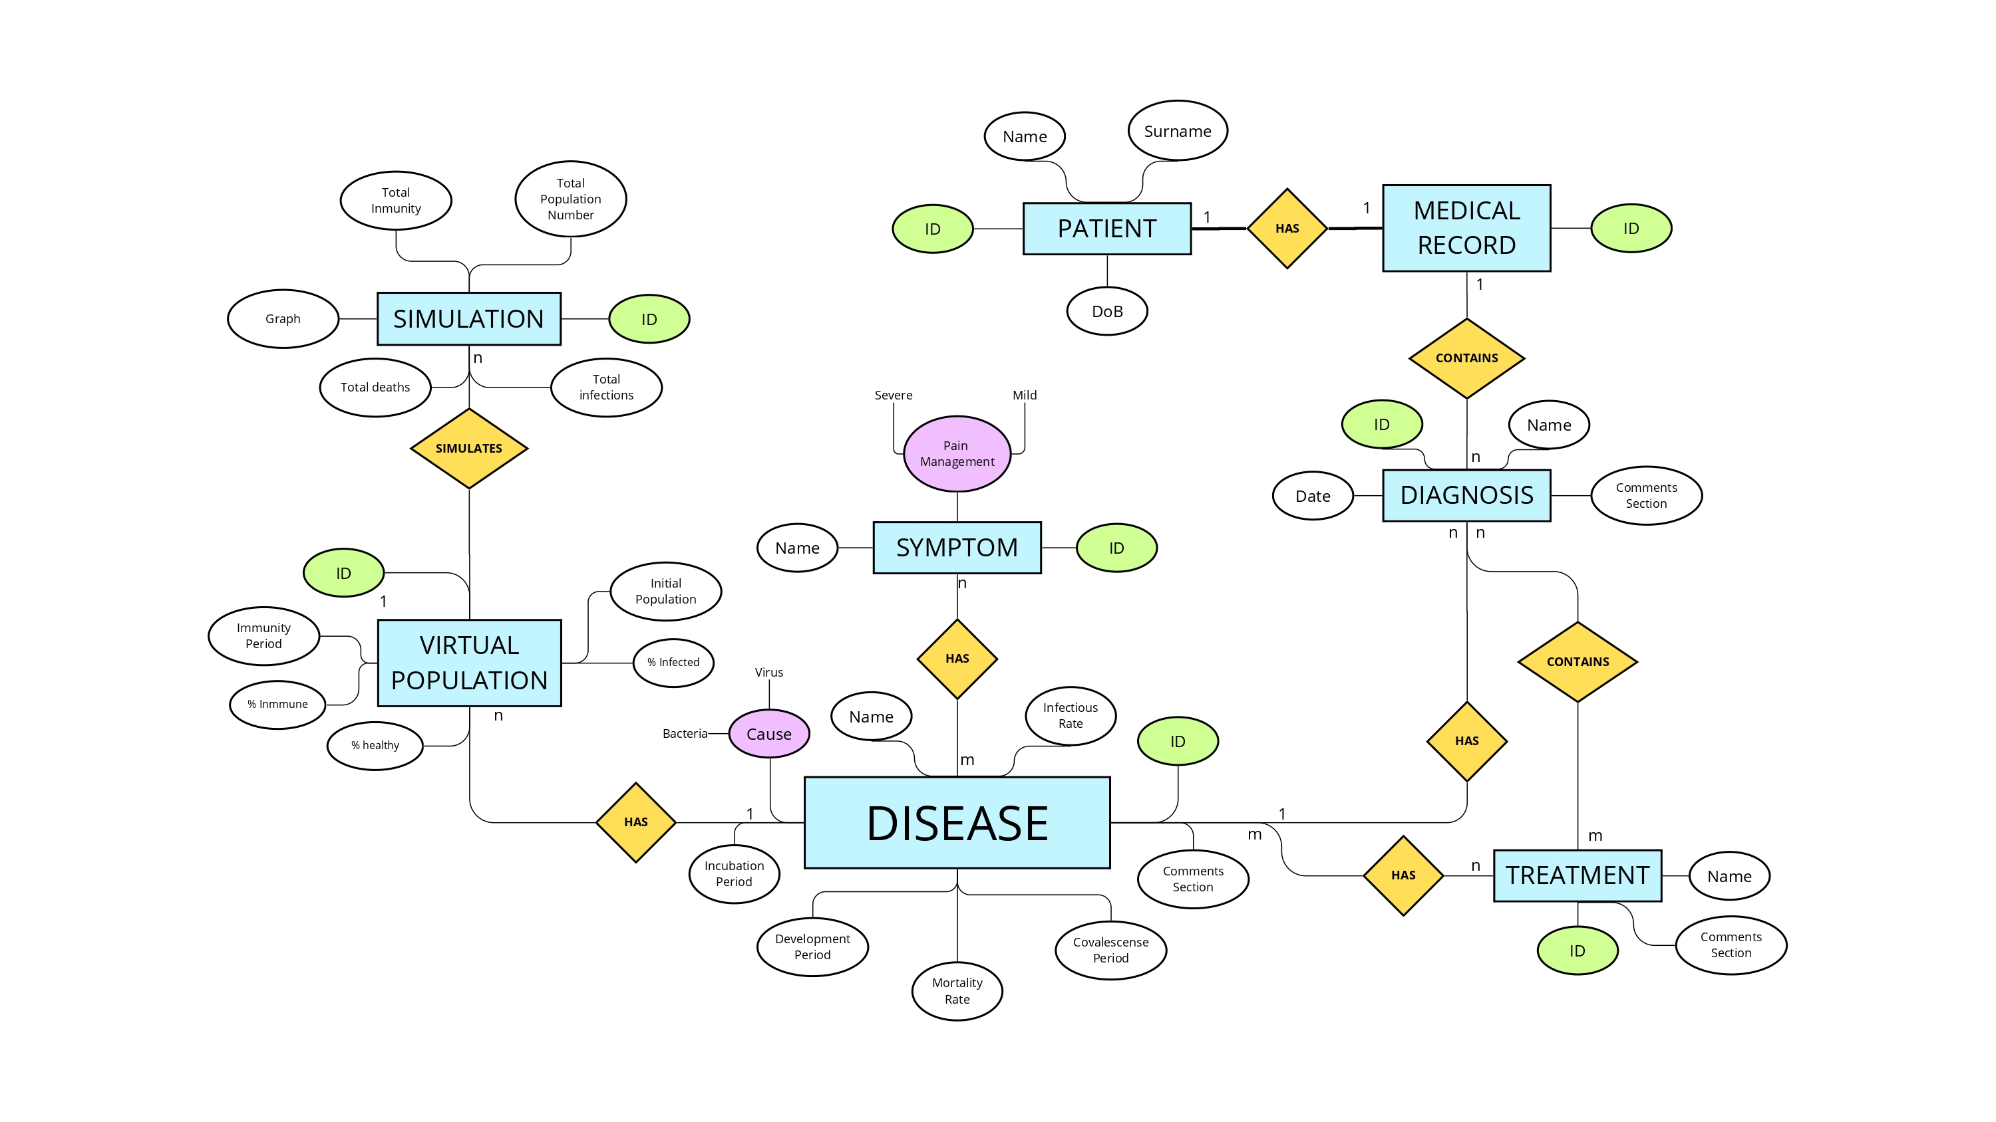
ER- DIAGRAM
IDSw
Home
About Us
Services
The Web
Contact

Slide 6
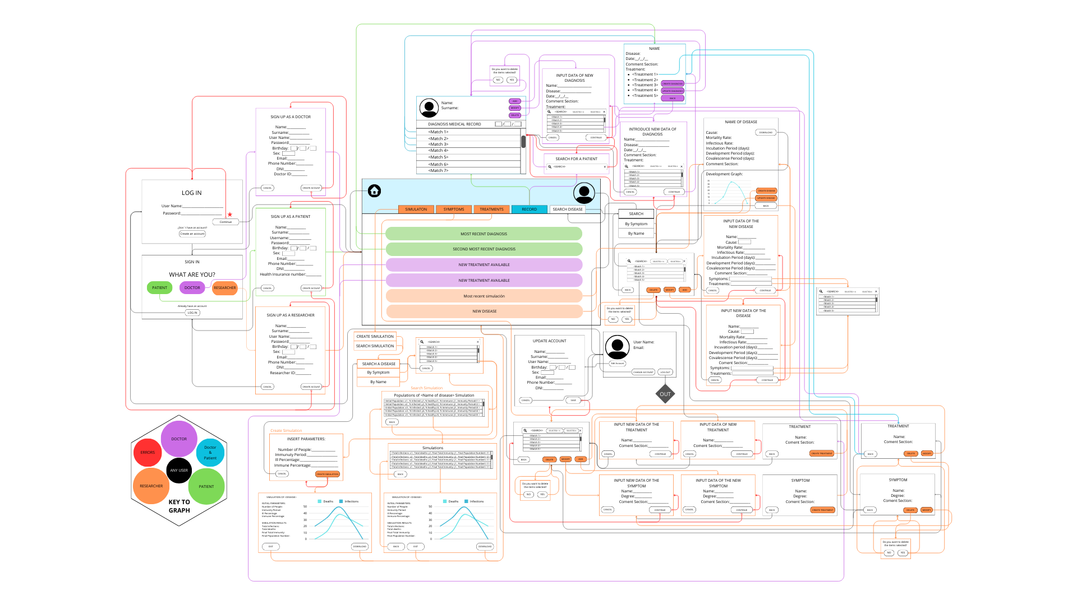
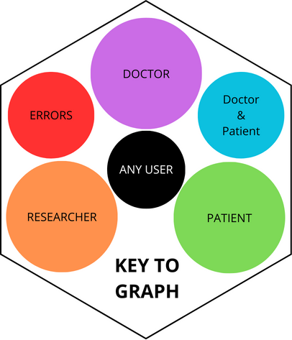
The Web
IDSw
Home
About Us
Services
The Web
Contact

Slide 7
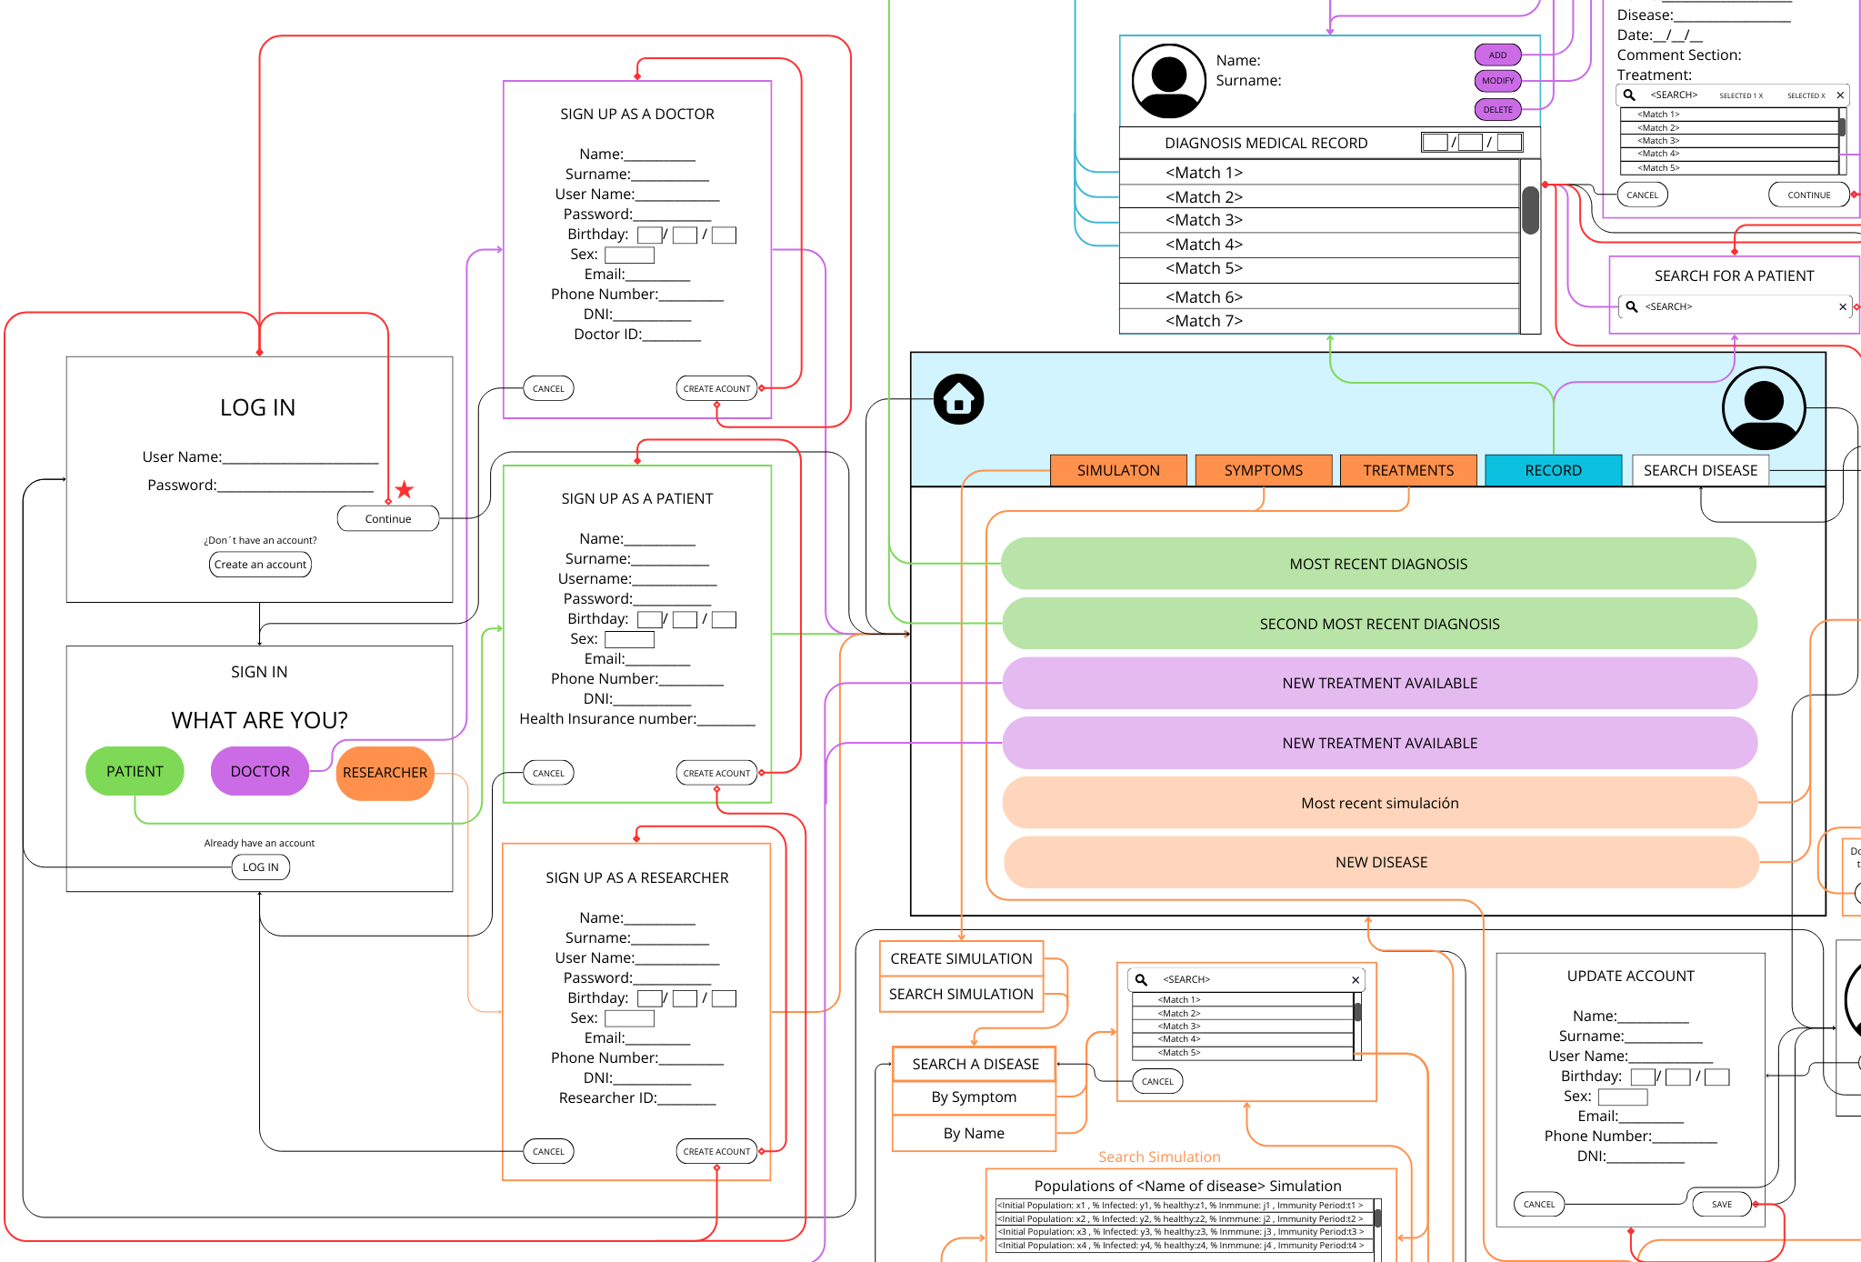
The Web
IDSw
Home
About Us
Services
The Web
Contact

Slide 8
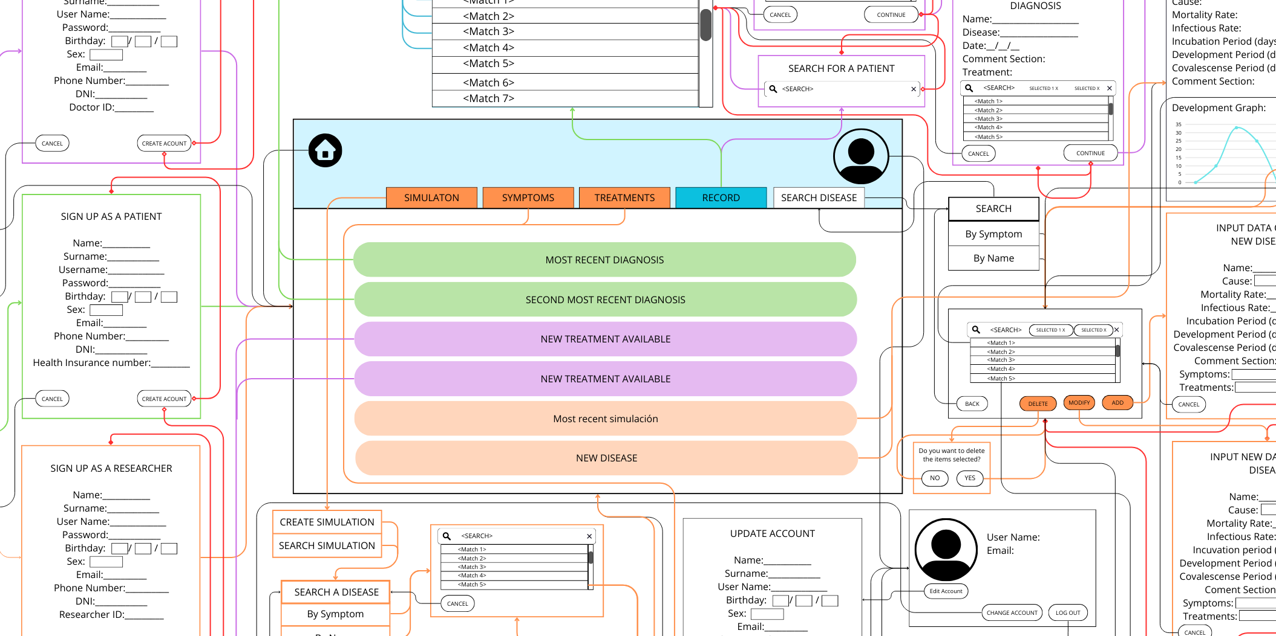
The Web
IDSw
Home
About Us
Services
The Web
Contact

Slide 9
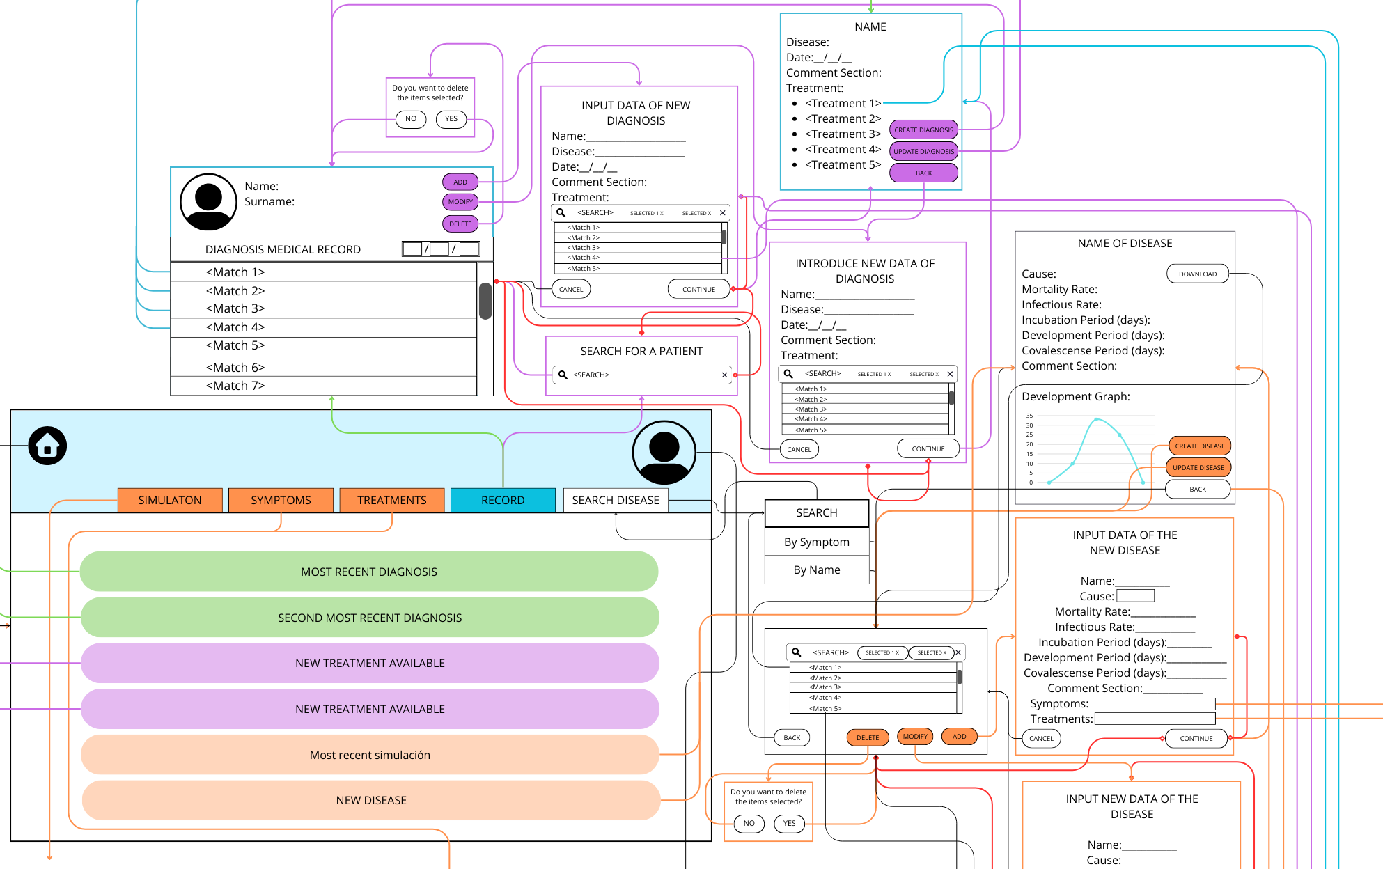
The Web
IDSw
Home
About Us
Services
The Web
Contact

Slide 10
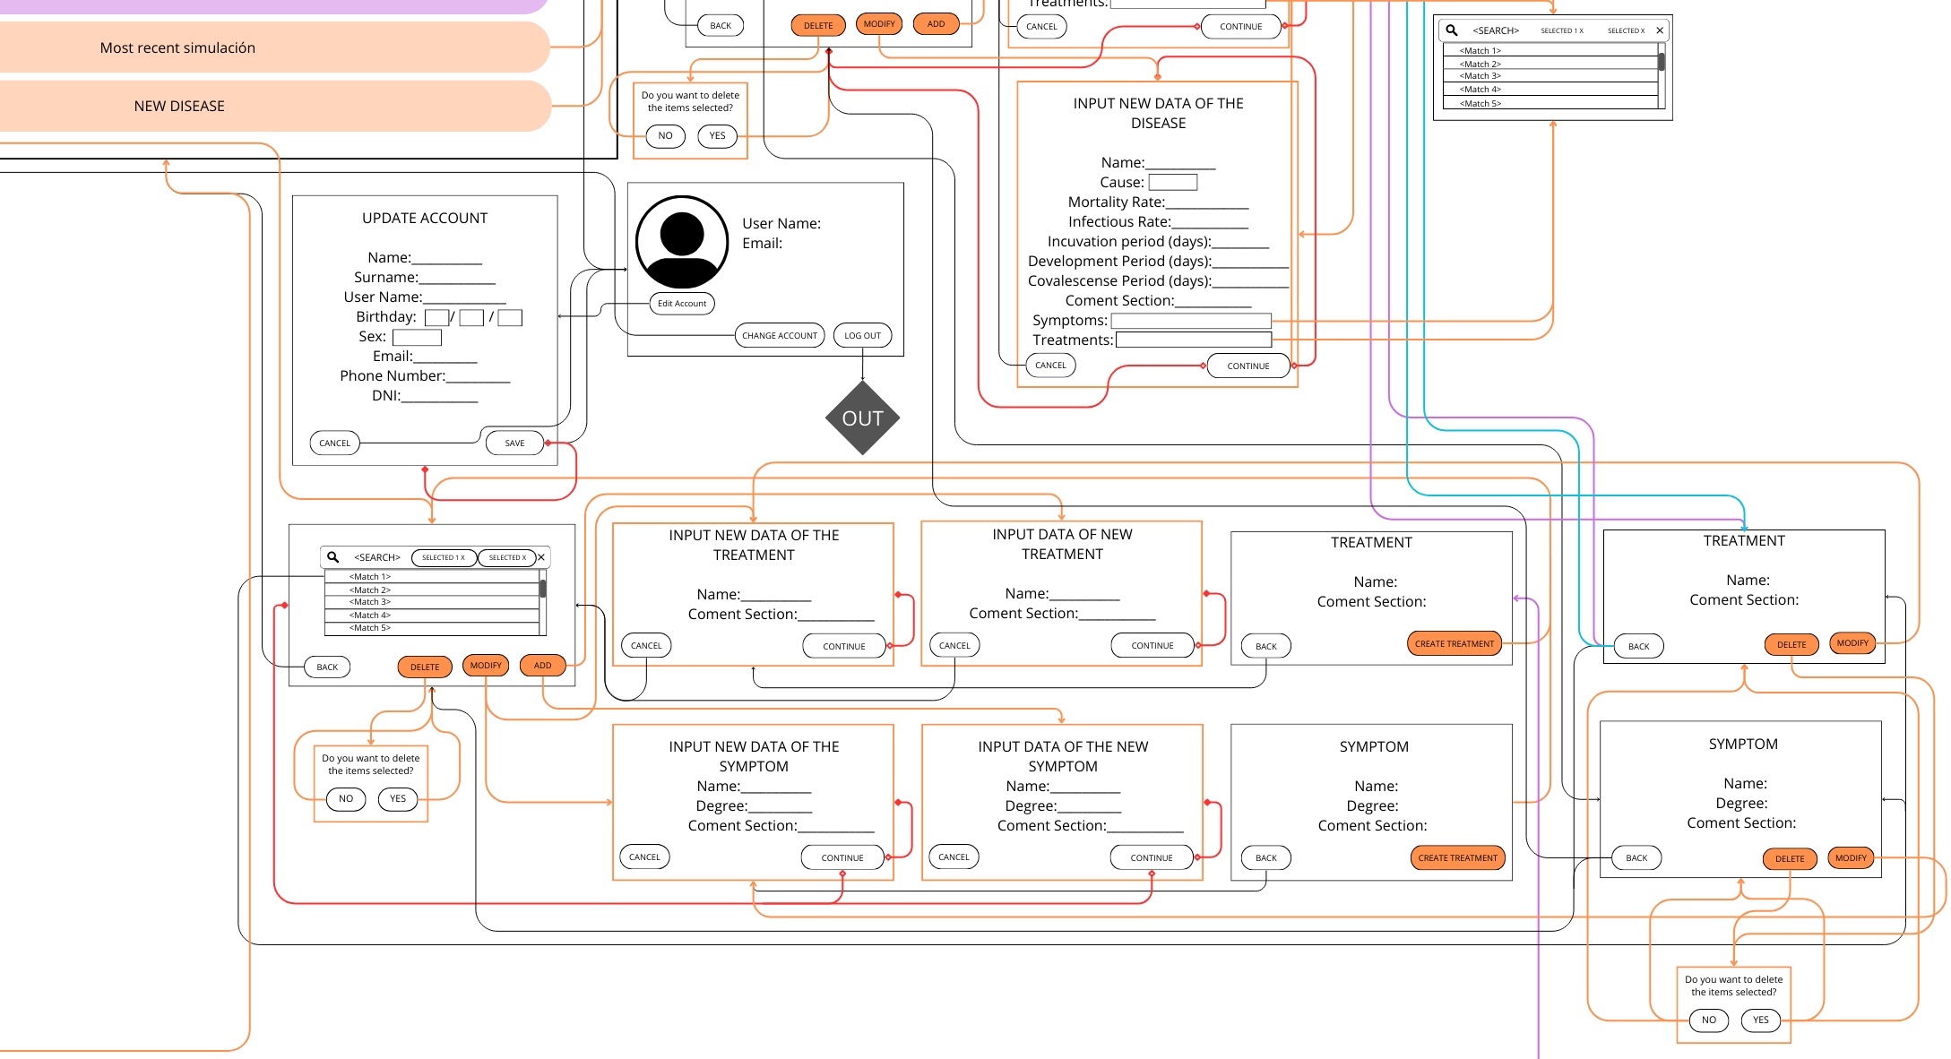
The Web
IDSw
Home
About Us
Services
The Web
Contact

Slide 11
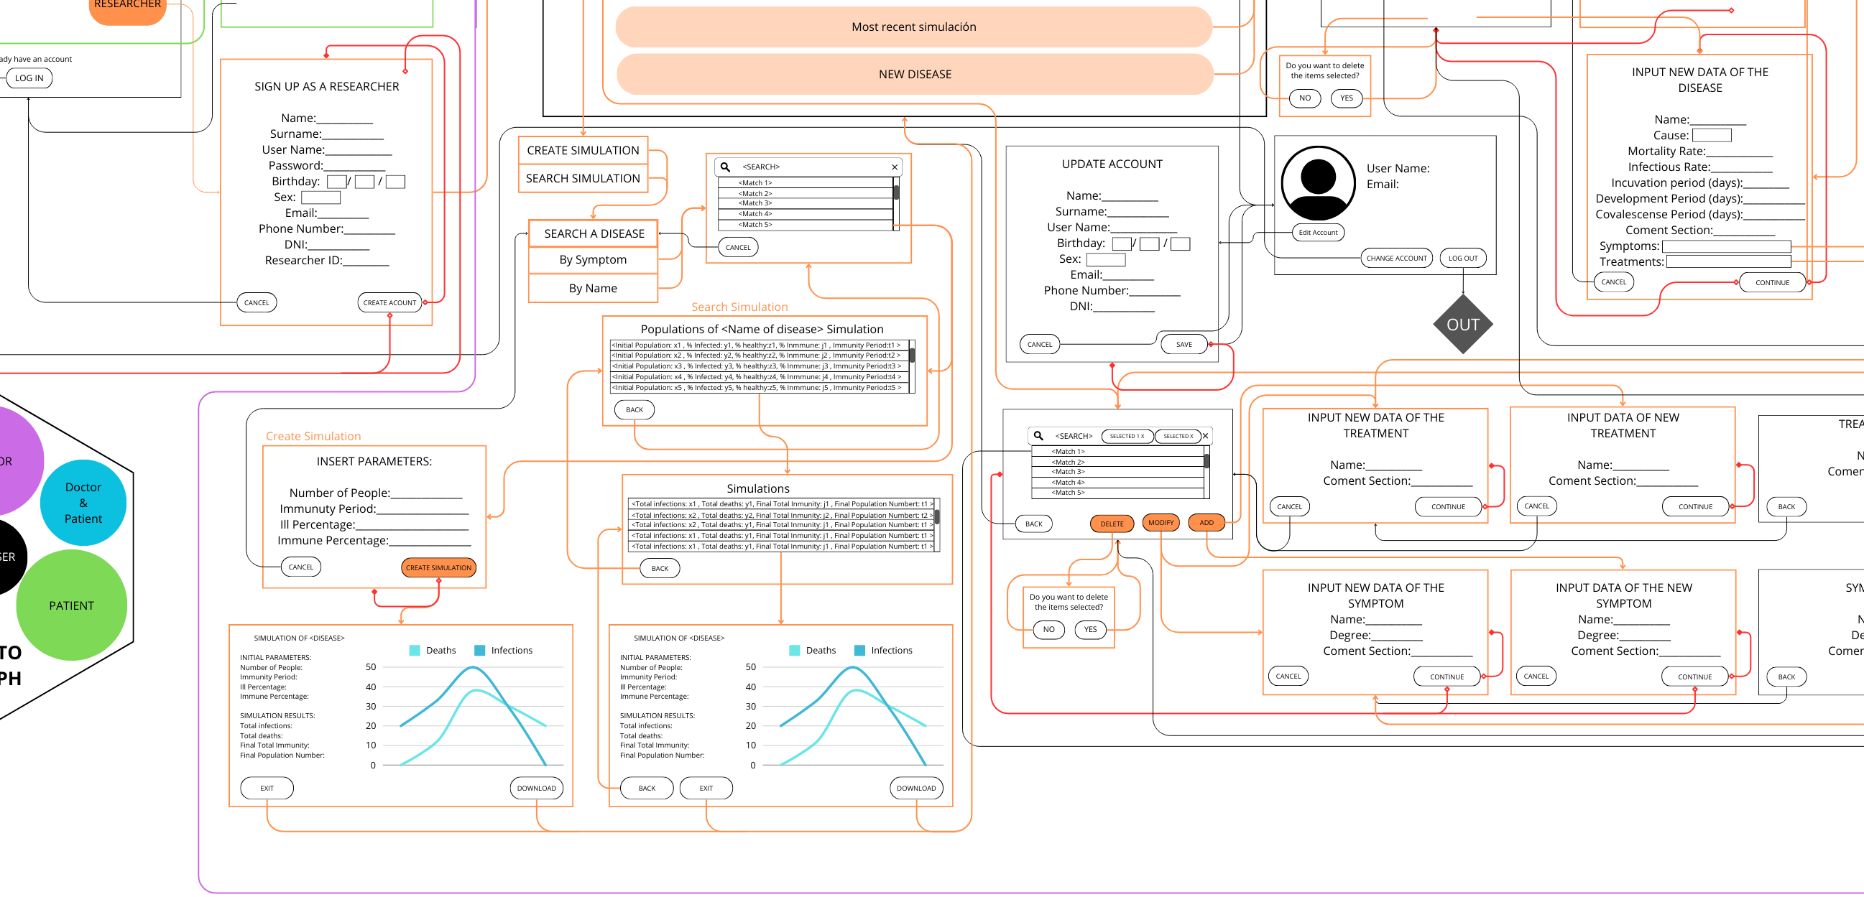
The Web
IDSw
Home
About Us
Services
The Web
Contact

Slide 12
The Web
IDSw
Home
About Us
Services
The Web
Contact

Slide 13
IDSw
Home
About Us
Services
The Web
Contact
THANKS!
Do you have any questions before we go on to the demo?

